Slide 1
How Does the web work :
The Web is a way of accessing information through the medium of the Internet , it uses Protocols ( Such as HTTP and HTTPS ) and allows applications to communicate, exchange and share information. The web also utilizes browsers such as Google Chrome, Internet Explorer , to access Web documents that are linked to each other via hyperlinks.
Let’s take a look , when you enter a web page , the first thing the client do is Typing the URL of the page he wants to access , the Web After Translating the IP address through DNS serveur , The Protocols and API’s Do the rest of the job to exchange informations between the server and the browser .

Slide 2
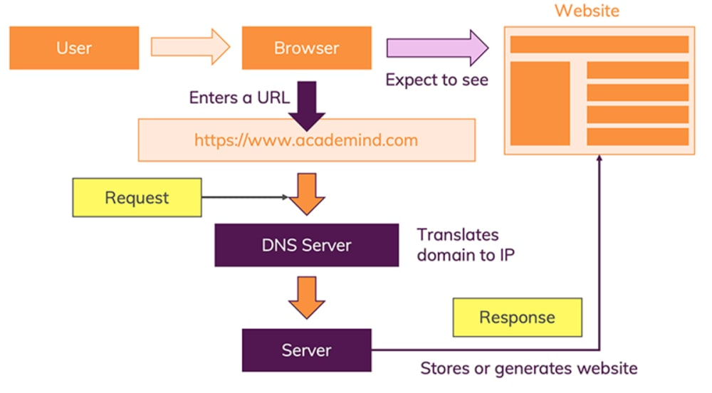

Slide 3
What do you need to be a web developer?
To be a web developer you have to be a curious Person , Someone That Has another Point of view to tackle and Resolve problems .
Passion is the Key . !
But as a web developer you have To Learn and Master the Most Known Coding Languages Such As :
HTML which you will use to describe the structure of your Page .
CSS to Determine the layout , colours and Fonts ( The visual Presentation of your pages .
JavaScript ( JS ) : it’s a super powerful tool to make your page interactive .
…

Slide 4
What is the role of a web developer.
Web developers need a combination of graphic design skills and technical computer skills that will allow them to create particular designs on web pages. In addition to looking nice, websites need to be functional and secure. It is the responsibility of web developers to create such sites that meet the requirements of employers or clients.

